Slide 1
Communication Protocols in a Digital Twin
Done by: Ang Zhengyang, Darren (1901354)
5th August 2022

Slide 2
Objectives
Researching and understanding Communication Protocols
International Electrotechnical Commission (IEC) 61850
MQ Telemetry Transport (MQTT)
Implementation of Communication Protocols onto Digital Twin
Digital Twin Structure using 24 Raspberry Pis
Node-RED Functionality

Slide 3
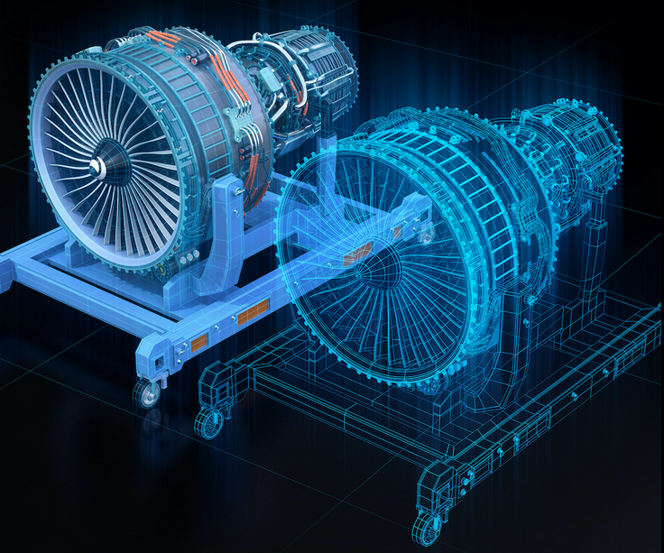
Digital Twin
Virtual representation model of a system or object
Replicating the physical system and simulating them
Analysis of cybersecurity vulnerabilities
Reference: Armstrong, M. M. (2021, April 26). What is Digital Twin? (photograph) Retrieved from https://www.ibm.com/blogs/internet-of-things/iot-cheat-sheet-digital-twin/
Notes:
uses real world data to create simulations that can predict how a product or process will perform.
Predictive maintenance/accelerated risk assessment

Slide 4
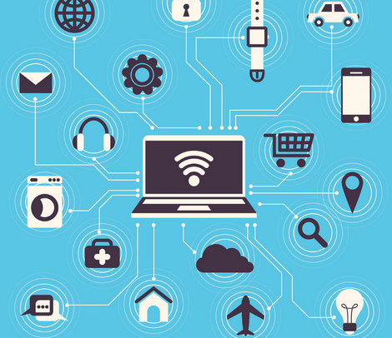
Communication Protocols
Set of rules and standards that permits data exchange between electronic devices via a connection
Computer networks would not exist without them
Reference: Techopedia. (2020, September 30). What is a communication protocol? (photograph) Retrieved from https://www.techopedia.com/definition/25705/communication-protocol
Notes:
transferring data and communication. Ensure that data sent from endpoint devices, such as sensors, is received and understood by the next and subsequent steps in the connected environment

Slide 5
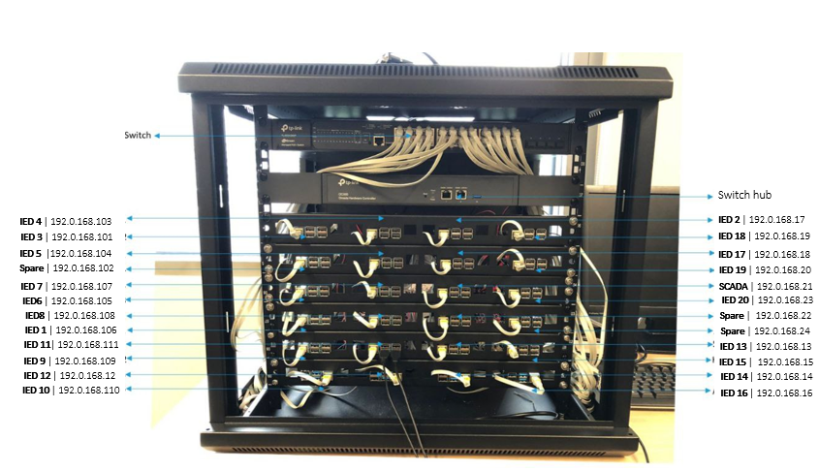
Digital Twin Structure

Slide 6
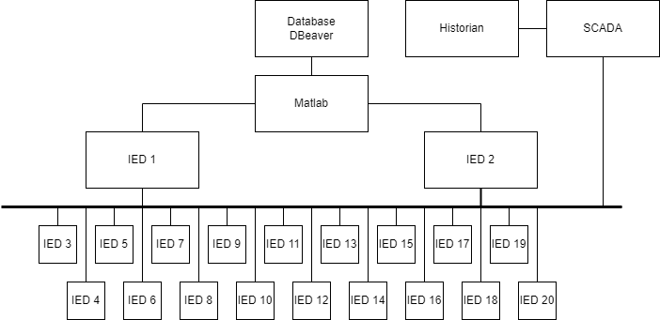
Digital Twin Structure

Slide 7
MATLAB
Through MATLAB Programming
Retrieves data values from SQLite Database in Dbeaver Software
Configure MQTT broker IP address to respective raspberry pi device
Publishing of data to respective IEDs
Subscribed to all IEDs’ events and circuit breaker statuses
Printing out text files which indicates the timestamps, events and statuses

Slide 8
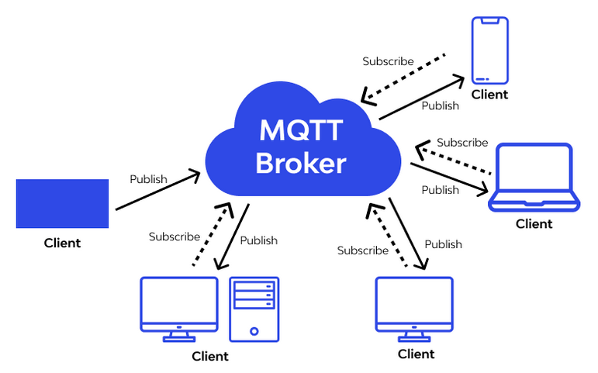
MQ Telemetry Transport (MQTT)
Publish/Subscribe Protocol
Via Centralized MQTT Broker
Built-In QoS Feature (Quality of Service)
Lightweight Capability
Reference: Wallarm.What is MQTT. all you need to know. MQTT concept. (photograph) Retrieved from https://www.wallarm.com/what/mqtt-concept
Notes:
Enables efficient and quick message delivery between electrical devices
QOS level 0 - simplest, lowest-overhead method (publishing without acknowledgement from broker)
QOS level 1 – guarantees message is transferred (acknowledgement from broker then stops sending, thus multiple messages might occur)
QOS level 2 – guarantees message is transferred (acknowledgement/handshake, sends message only once)

Slide 9
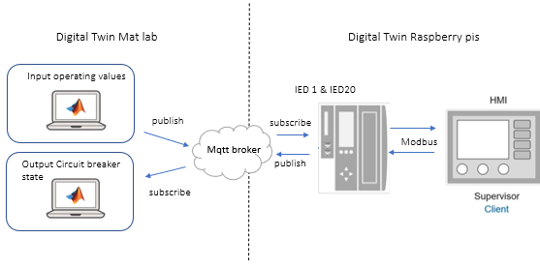
MQ Telemetry Transport (MQTT) Architecture

Slide 10
MQ Telemetry Transport (MQTT) Architecture
11 MQTT Brokers for 11 MQTT Topics:
Voltage 1
Voltage 2
Voltage 3
Current 1
Current 2
Current 3
Voltage Neutral
Current Neutral
Frequency
Load
Subscribe
for MATLAB
MQTT Broker 1
MQTT Broker 2
MQTT Broker 3
MQTT Broker 4
MQTT Broker 5
IED 1-20
MATLAB
SCADA
HISTORIAN
MQTT Broker 6
MQTT Broker 7
MQTT Broker 8
MQTT Broker 9
MQTT Broker 10
MQTT Broker 11

Slide 11
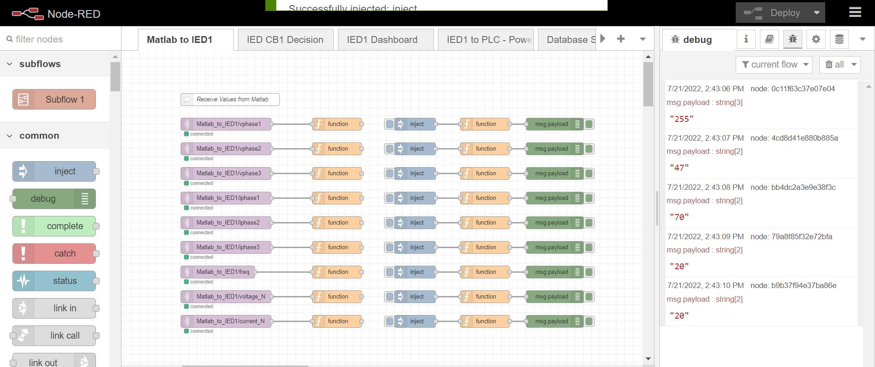
Implementing on Node-RED
MATLAB to IED nodes configuration example

Slide 12
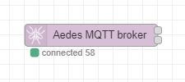
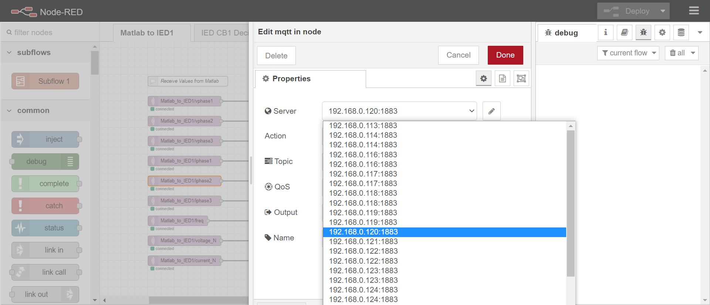
Implementing on Node-RED
MQTT Broker (Aedes)
Configuration of MQTT node

Slide 13
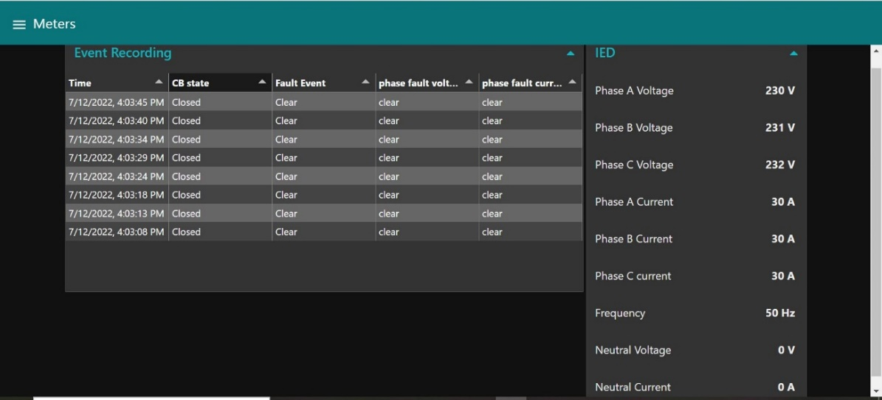
MQ Telemetry Transport (MQTT)
Example IED1 Dashboard with data values

Slide 14
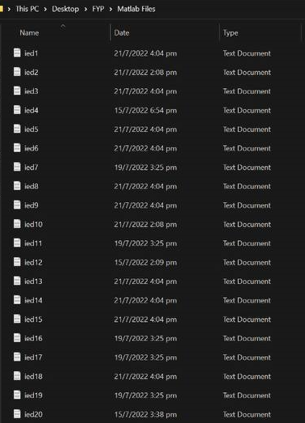
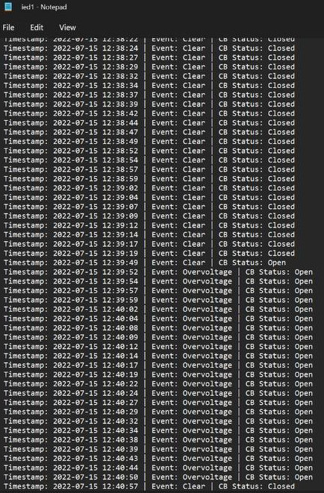
MQ Telemetry Transport (MQTT)
Output Text Files from MATLAB showing events and statuses

Slide 15
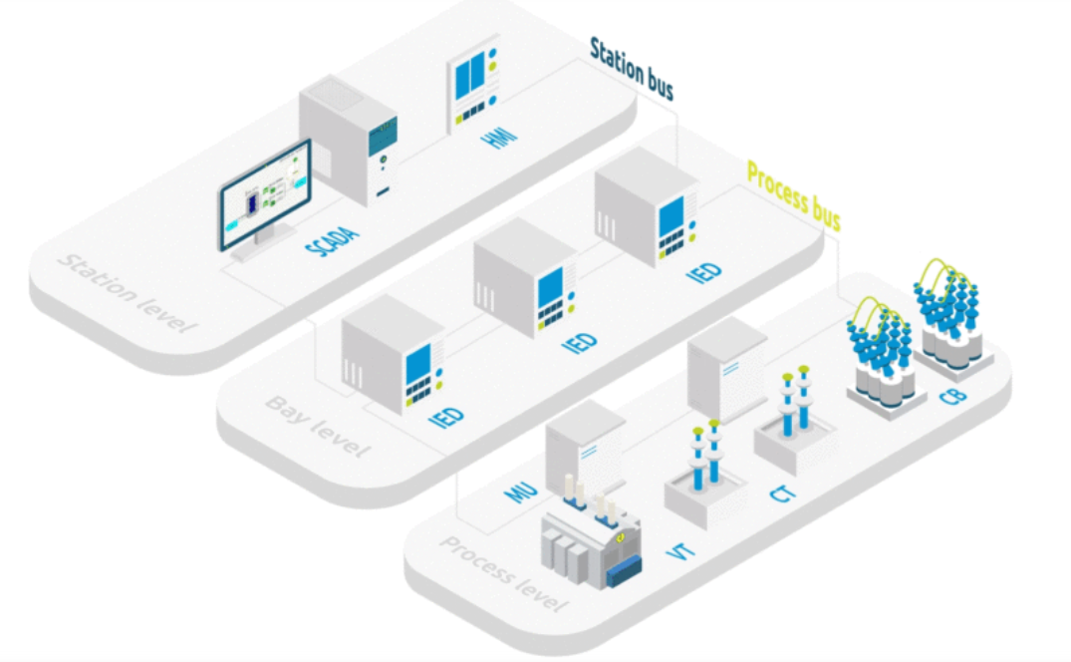
International Electrotechnical Commission (IEC) 61850
Specifies communication protocols for intelligent electronic devices found in electrical substations
3 main protocols – MMS, GOOSE and SMV
Interoperability Capability (Integration or implementation of devices from different manufacturers)
Reference: Basic understanding of IEC 61850 - what are the key aspects? (photograph) Retrieved from https://www.sgrwin.com/basic-understanding-iec-61850/

Slide 16
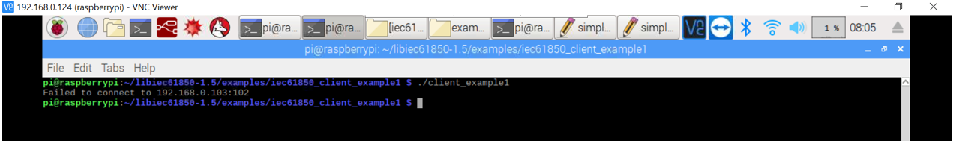
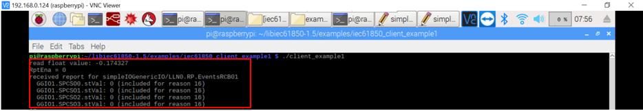
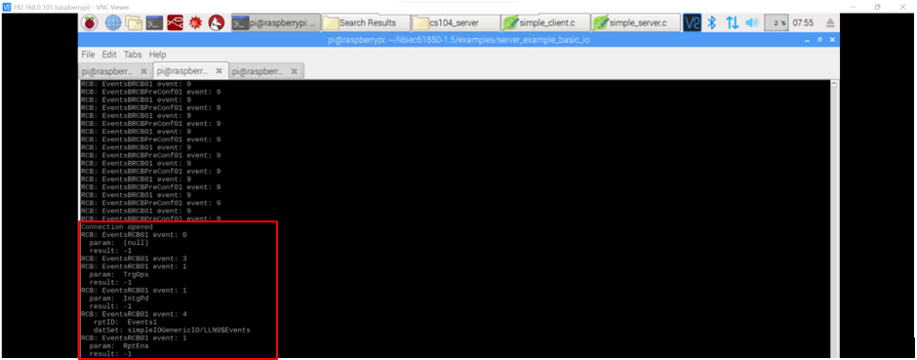
International Electrotechnical Commission (IEC) 61850
C-Files configuration for IEC 61850 communication

Slide 17
Future Works
Integration of IEC 61850 onto Digital Twin
Analyzing Cybersecurity Vulnerabilities of the Digital Twin
Ettercap
Wireshark

Slide 18
Thank you

